Slide 1
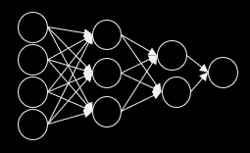
Classifying Melanoma Types from Skin Lesion Images
Neural Networks & Deep Learning Project
Advised By : Dr. Farid Alizadeh
Submitted by:
Nivetha Vedanarayanan
Radhika Rajeevan
Weijun Zhu
Xinran Li
Neural Networks & Deep Learning Project
Advised By : Dr. Farid Alizadeh

Slide 2
Objective
In this project, we aim to explore the application of Neural Networks in Image Classification for medical diagnosis.
We are using dermoscopic images of pigmented skin lesions and identifying the melanoma type that it belongs to.

Slide 3
Motivation
Melanoma are cancerous in nature; however the degree of malignancy differs based on each type.
In 2015 there were a total of 350,000 cases of skin cancer with 60,000 deaths (17%)
If diagnosed early, melanoma survival exceeds 95%
Ref- https://challenge2018.isic-archive.com/

Slide 4
Introduction
Data source
Exploratory Data Analysis
Pre-processing
Approaches
Building CNN
Feature Extraction
Pretrained Model Architecture
Reusing Pretrained Weights
Comparing Models

Slide 5
Data Source & Extraction
The Skin Lesion Images were made available on Kaggle as part of a Melanoma Detection Challenge by the International Skin Imaging Collaboration (ISIC).
There are 10,015 dermoscopic colored images classified into 7 different melanoma types.
Data is extracted from Kaggle into Google drive using Kaggle API.

Slide 6
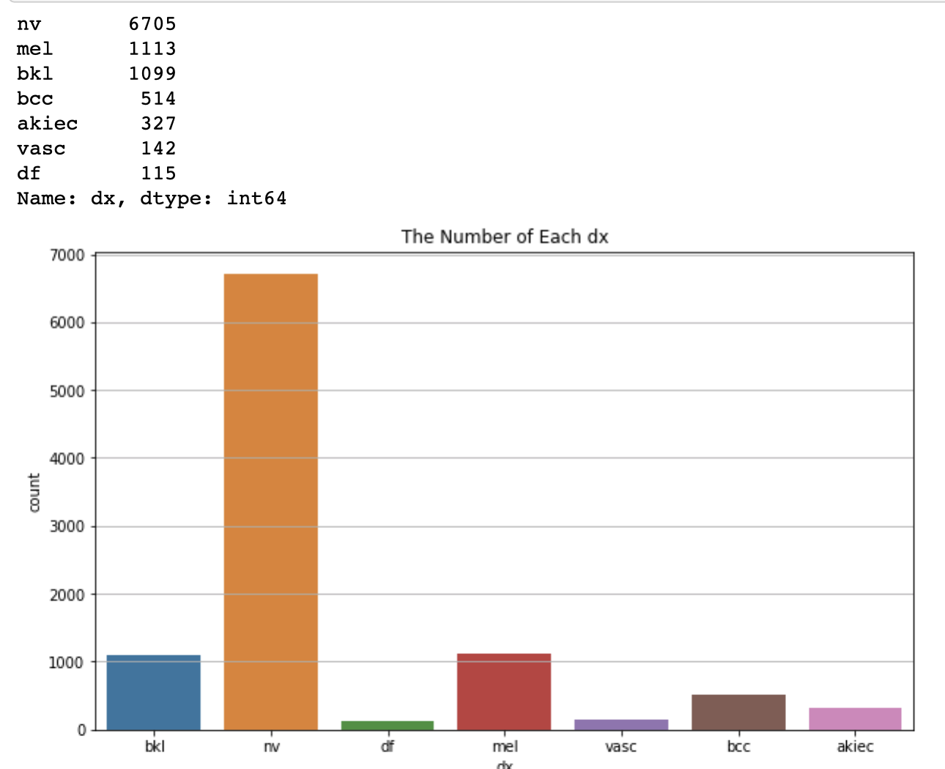
EDA Findings Melanoma Types ‘dx’
By visualizing data, we can tell that the “nv” type is the most common melanoma type. The quantity of “nv” exceed over ½ of the overall collected images.
The other melanoma types are: “bkl”, “df”, “mel”, “vasc”, “bcc”, “akiec”

Slide 7
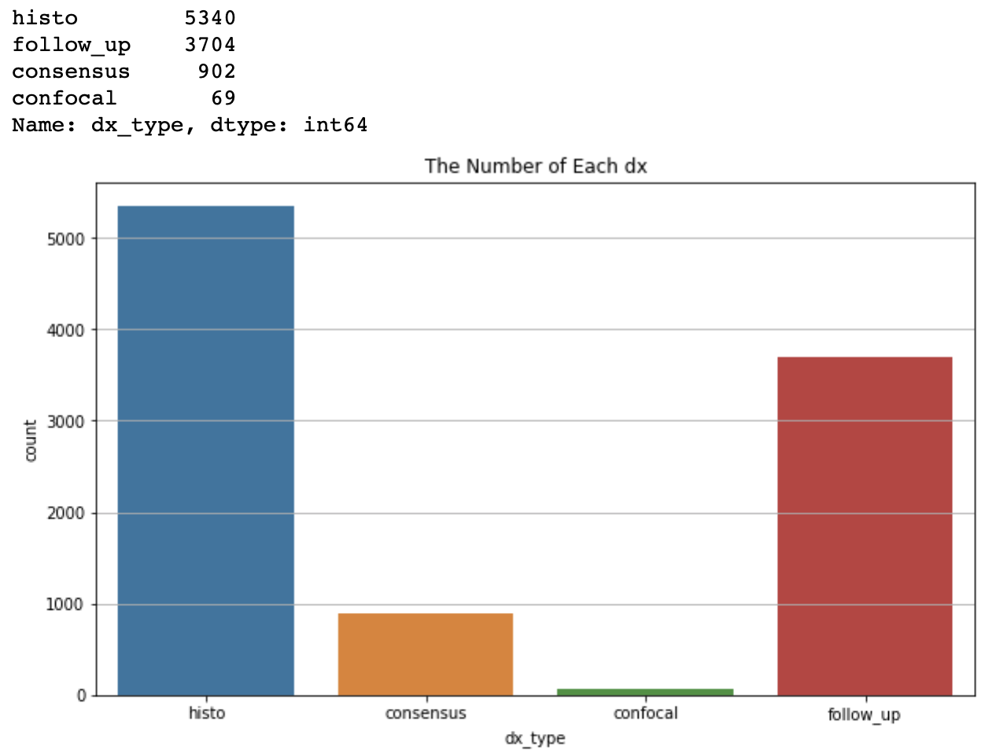
EDA Findings Confirmation ‘dx type’
We notice from the visualization that over 50% of lesions are confirmed through “histo”.
While “follow_up” play another major role in confirming cases, we could also confirm by “consensus” and “confocal”.

Slide 8
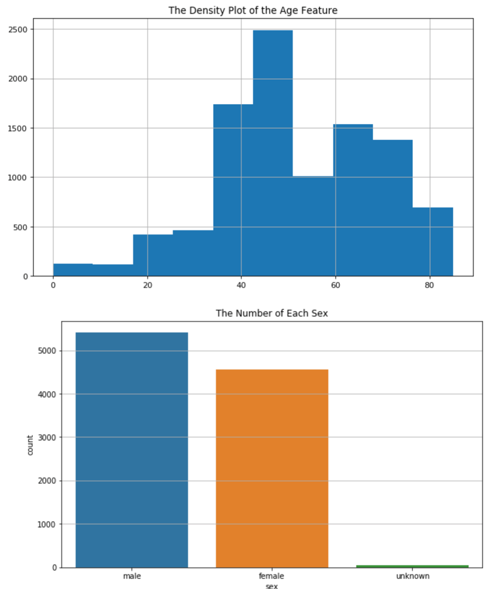
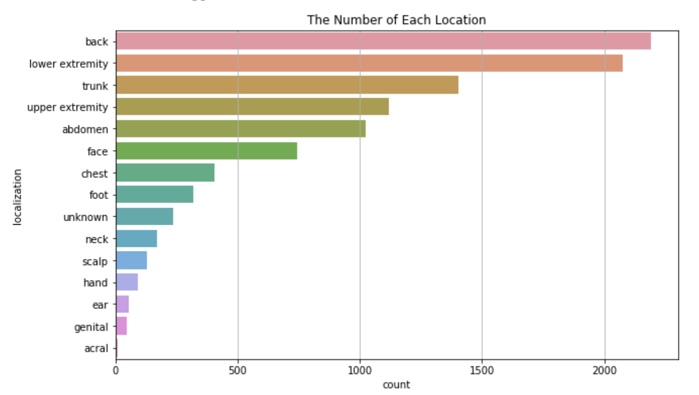
Additional features

Slide 9
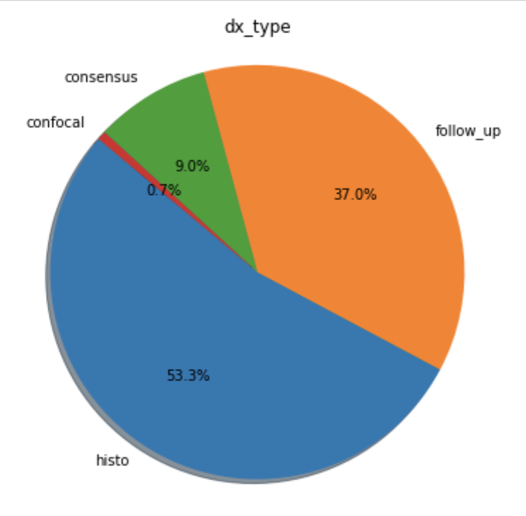
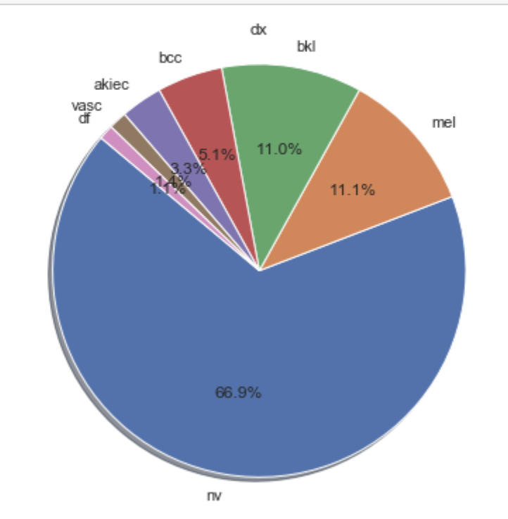
Additional features

Slide 10
Preprocessing
Scaling Data
Images were converted to numeric arrays and scaled between 0 and 1 and saved as npy files.
We have tried models with 3 different dimensions:
128 x 128 x 3
150 x 150 x 3
224 x 224 x 3
Class Imbalance
Since class proportions are highly skewed, we have used Data Augmentation to generate rotated images for classes with less training data for a class-wise balance.

Slide 11
MobileNet
MobileNet with 128 x 128 x 3 arrays
Train-Val-Test Split
Model Architecture
Learning Rate
Accuracy & Loss
Performance on Test Data
Confusion Matrix
Precision & Recall

Slide 12
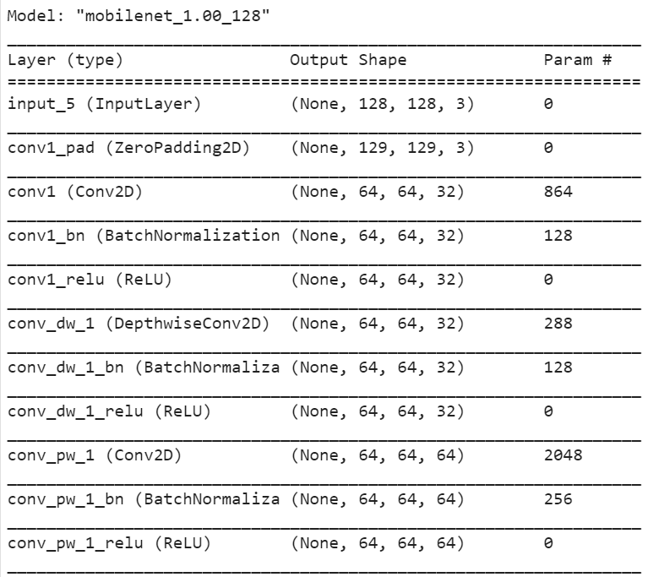
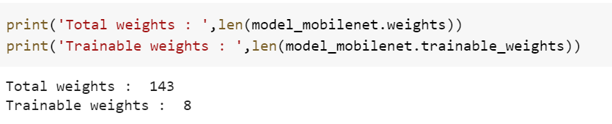
MobileNet Architecture
Freeze the pretrained MobileNet weights

Slide 13
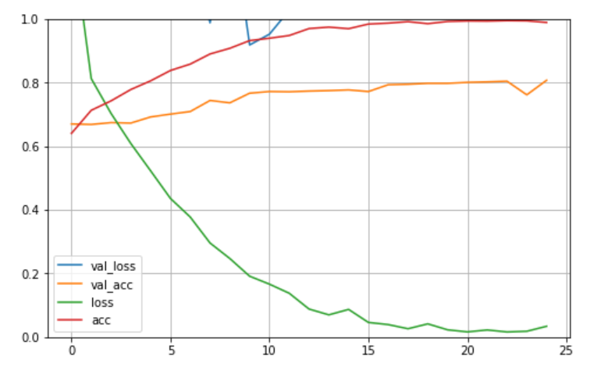
MobileNet Performance
Learning Rate of 0.0001
Optimizer - RMSProp
The validation loss is > 1 and does not drop
Validation accuracy does not improve beyond 80%

Slide 14
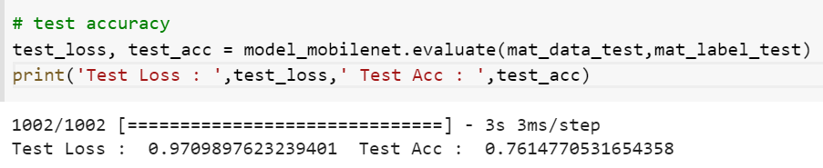
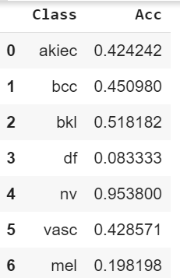
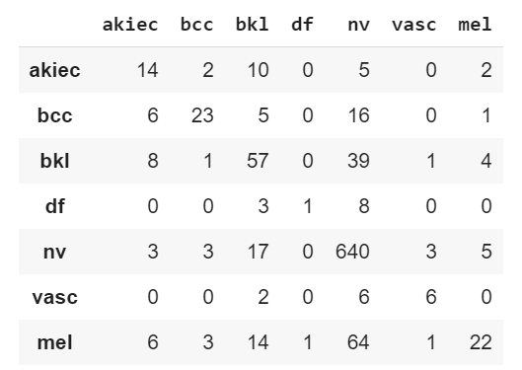
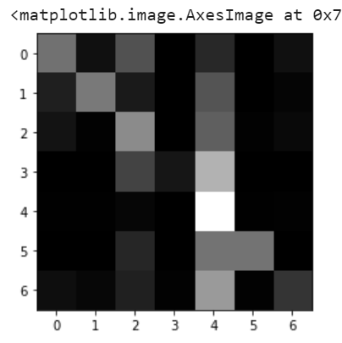
MobileNet Test Data
Identification of ‘df’ is extremely low : 8%
Except ‘nv’ rest of classes have an accuracy of <= 50%

Slide 15
MobileNet with Data Aug
MobileNet with Data Augmentation
Images are Generated on Imbalanced class images
Model Architecture
Learning Rate
Accuracy & Loss
Performance on Test Data
Confusion Matrix
Precision & Recall

Slide 16
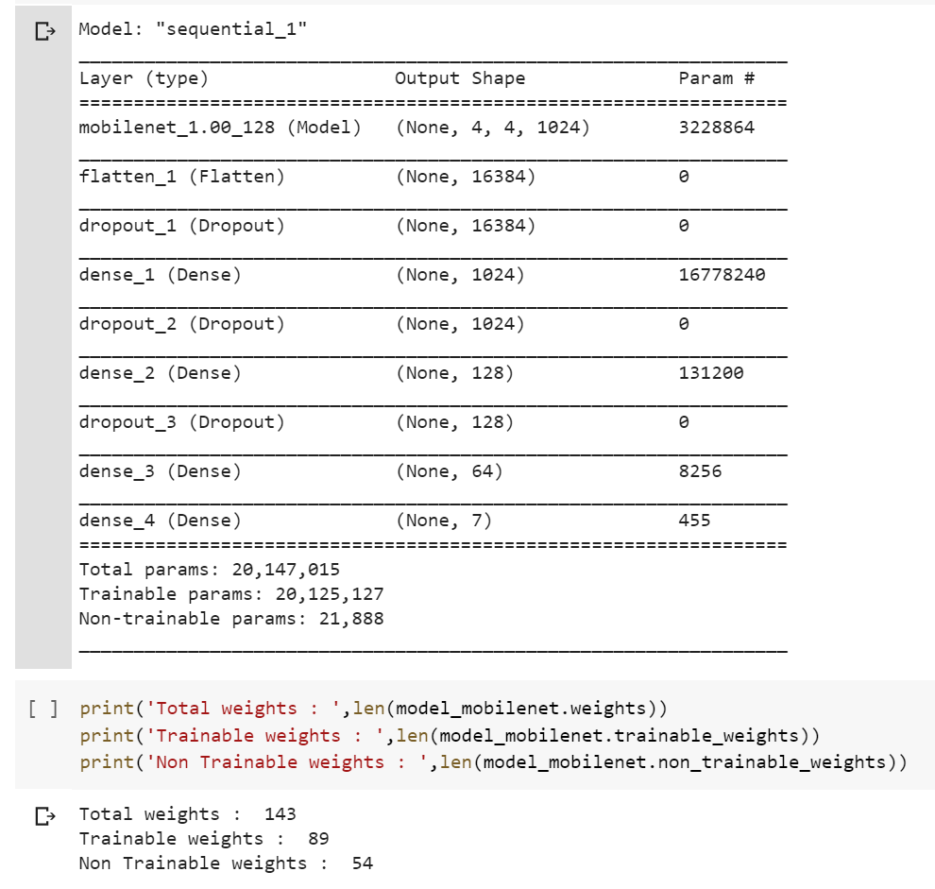
MobileNet-DA Architecture
Freeze the pretrained MobileNet weights

Slide 17
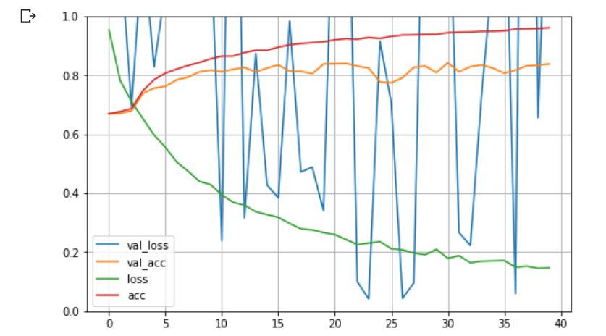
MobileNet-DA Performance
Learning Rate of 0.0001
Optimizer – RMSProp
steps_per_epoch=(train_size/batch_size)
High fluctuation in validation loss
Validation accuracy improves slightly beyond 80%

Slide 18
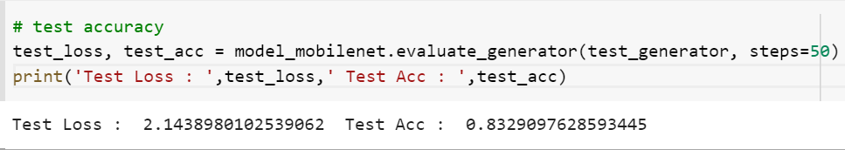
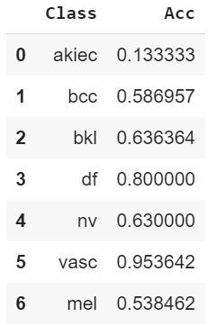
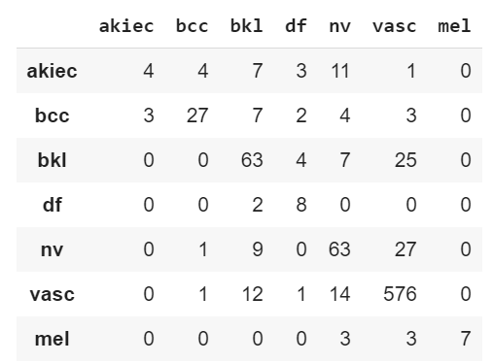
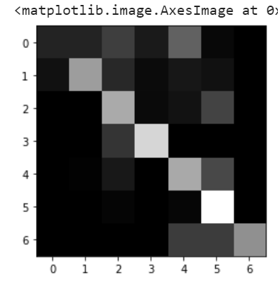
MobileNet-DA Test Data
Identification of ‘df’ is extremely low : 8%
Except ‘nv’ rest of classes have an accuracy of <= 50%

Slide 19
Improvements
Downgrades
Accuracy for ‘akiec’ has dropped from 42% to 13%
‘nv’ has dropped from 95% to 63%
Identification of ‘df’ has improved from 8% to 80%
Fewer misclassifications

